Slide 1
ECE 143 Final Project: Financial Career Consulting Group 4: Arik Horodniceanu, Chi Zhang, Changhao Shi
Notes:
Say names, introduce subject.

Slide 2
Overview
Motivation and Objective
Data
Analysis
Conclusions
Suggestions for Further Research

Slide 3

Motivation and Objective
What should I study?
Which area should I go to school in?
Are private or public schools better?
Our approach is financially driven: The best choice is the most profitable one.
Notes:
Go back to high school. What should I do next? College. Money=happiness.
To reach a conclusion, we reduced the main question of career and school selection into 3 sub questions.
We answer the 3 above questions and determine the optimal decisions.

Slide 4
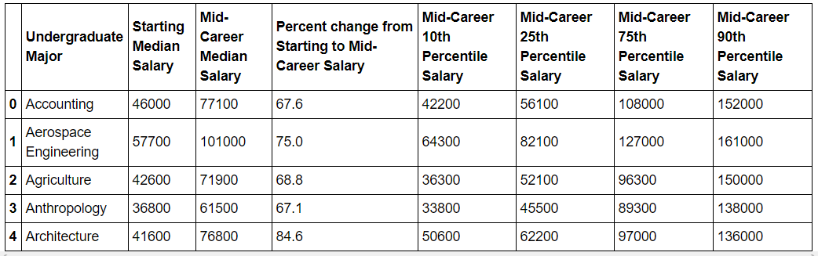
Data
We used the Kaggle database “Where it pays to attend college”.
Code was written using Python 3.6 and its data visualization libraries.
Notes:
Dataset contained information about universities and majors.
Added information manually. Used information about 270 universities and 50 undergraduate majors in 2 CSV files.
Used Numpy, Matplotlib, Pandas and Seaborn.

Slide 5
Analysis
Which profession should you choose?
Where should you study?
What type of school is best?
Notes:
Simplify, answer 3 question, reach unified answer to main question.

Slide 6
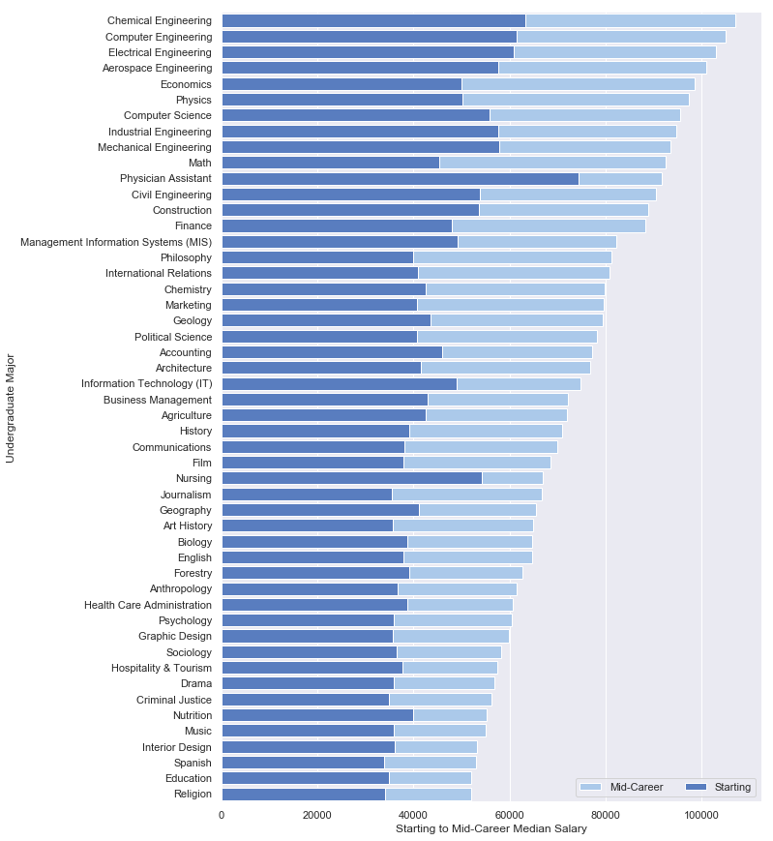
Which profession should you choose?
8/10 top median starting salaries are Engineering.
7/10 top median mid-career salaries are Engineering.
Notes:
2 out of top starting salaries are medicine related. 3 out of top median salaries are STEM

Slide 7
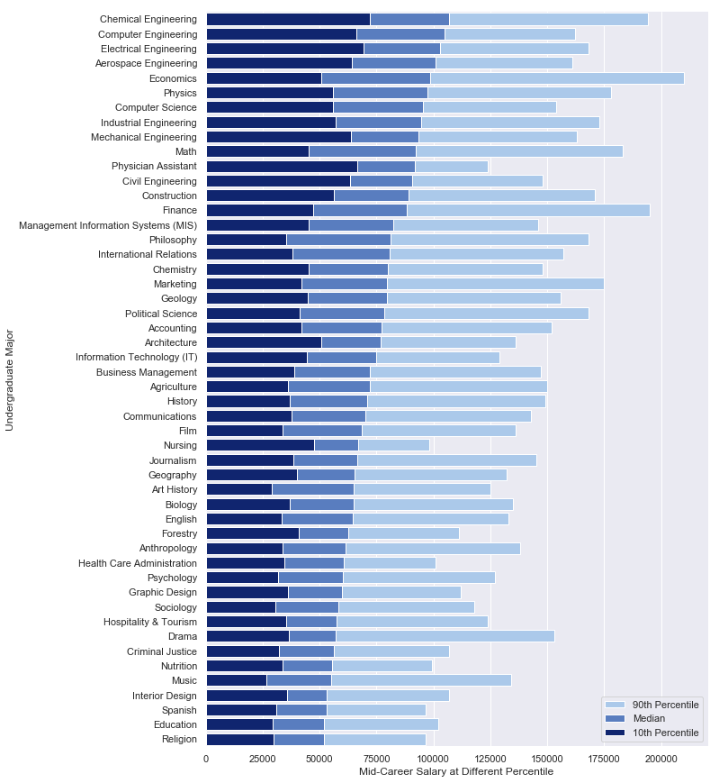
Which profession should you choose?
Engineers consistently make more.
Economy related professions pay to be the best.
Notes:
Know money to make money. 2 out top 3 90th percentile are economics and finance.

Slide 8

Inference
Engineering is the most profitable career choice but can’t go wrong with most STEM.
Want to make the most money right out of school? Physician Assistant is best. Doesn’t increase as much over the years.
If you’re talented at anything, you’ll be fine. Better to be a great engineer than a great anthropologist.
Don’t like math or medicine?
Notes:
Better to call this guy for a job than count on social science studies

Slide 9
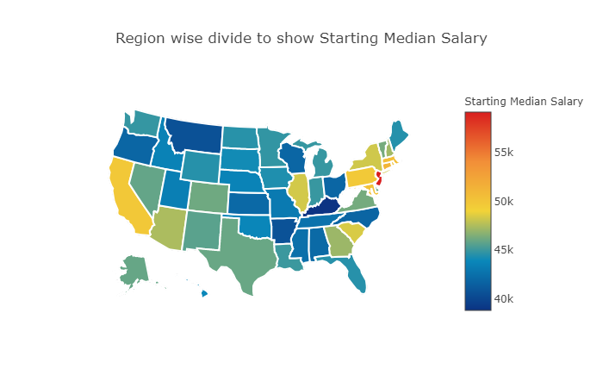
Where should you study?
Highest salaries concentrate mostly in coastal states.

Slide 10
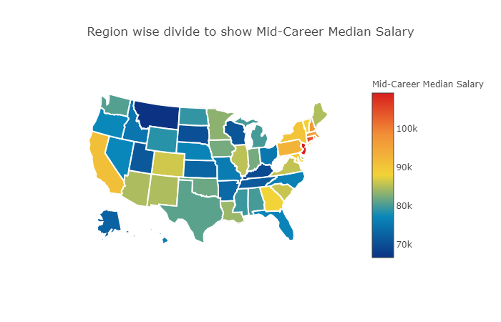
Where should you study?
Region-wise division remains steady over entire career.

Slide 11

Looking for good weather on the West Coast? Look no further than California.
More of a rain person? The East Coast is for you: New York or Massachusetts.
Anywhere else? Not the best choice.
Notes:
Not much difference between coasts, California has large selection for 1 state.

Slide 12
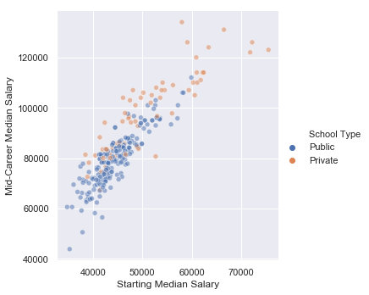
Which type of school is best?
Private schools show more variance in salaries.
Salaries are overall higher in private schools.

Slide 13
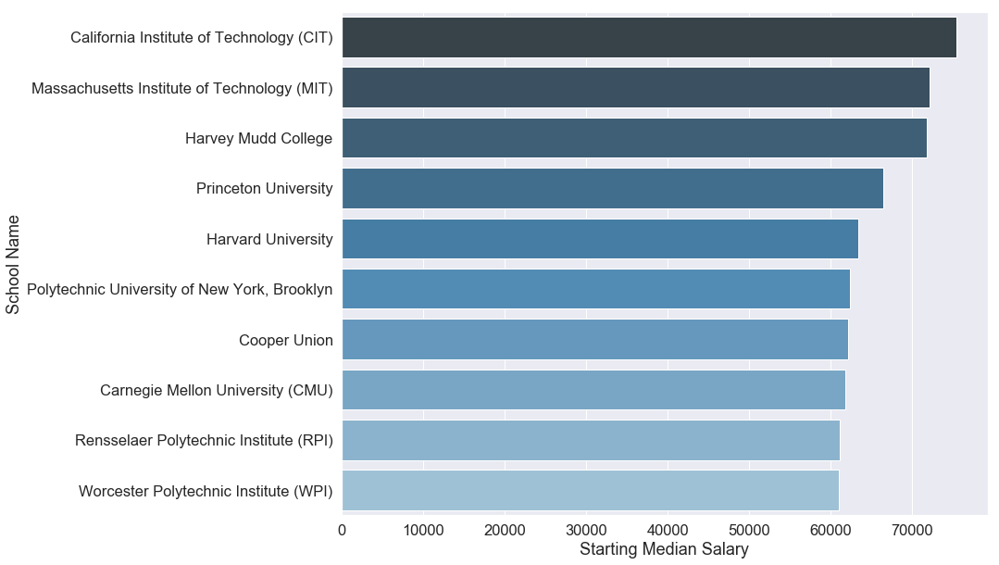
Which type of school is best?
Top 10 highest starting median salaries, by school

Slide 14
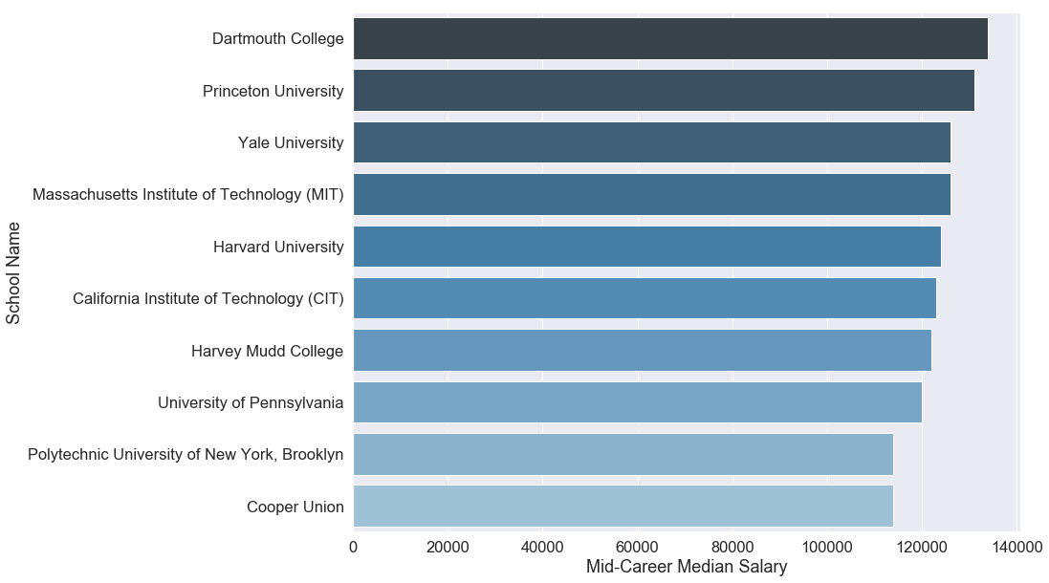
Which type of school is best?
Top 10 highest mid-career median salaries, by school

Slide 15
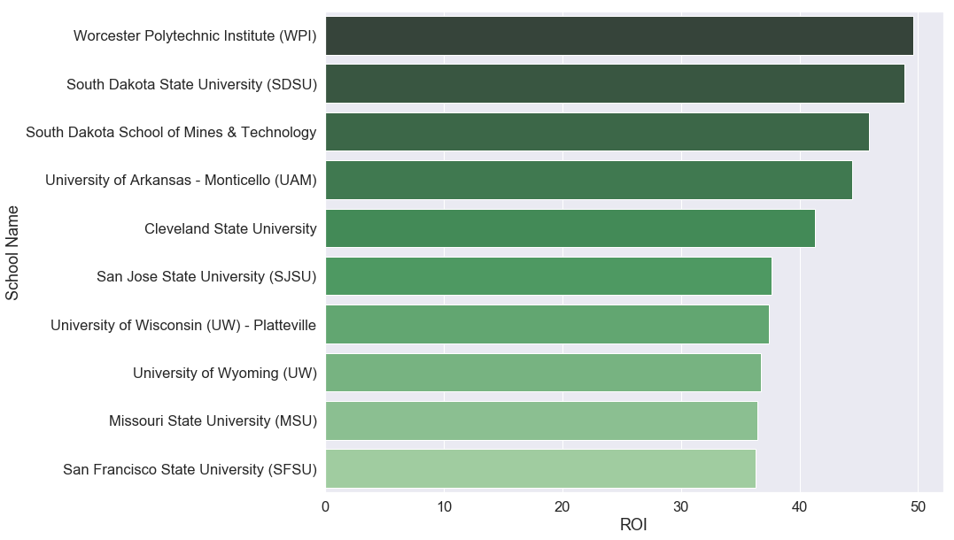
Which type of school is best?
ROI = (Gain – Cost)/Cost. Top 10 ROI schools

Slide 16
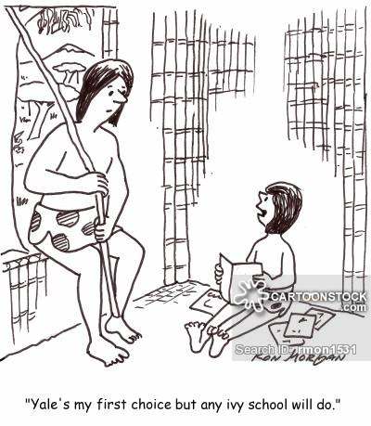
Top 10 best ROI schools are public schools. Best return at state schools, mostly in California or New York.
Top 10 highest salaries are from private schools. Best choices are Ivy League schools.

Slide 17
Conclusions
Good idea to be an Engineer. Better idea to be a great engineer.
East coast or West coast doesn’t make much difference. Depends more on personal preference.
Have the money to spend? Spend it on a top education. Don’t have enough for private schools? State schools offer good tradeoff.

Slide 18
Suggestions for further research
Effect of graduate studies on salaries.
Rankings based on weighted average of ROI, salaries or other metrics.
Connection between salaries and GPA.
Many more.

Slide 19
THANK YOU
Any questions?

